Slide 1
Weather Conditions and Climate Change with ClimateWins
August
2024
Machine Learning with Python
Oksana Stepanova

Slide 2
Objective
ClimateWins is a non-profit organization and interested in using machine learning to help predict the consequences of climate change around Europe and, potentially, the world.
The objective of this project is to master machine learning techniques and identify the best resources for predicting climate change.
In the first stage of the project, we have to determine which areas can use machine learning, then train machine learning using the data with included answers (supervised learning) and finally identify the best model to start making predictions.

Slide 3
Hypothesis
ClimateWins concerns with the extreme weather events in the past 10 to 20 years. We believe that weather extremes can be predicted by using advance machine leaning tools.
Can machine learning be used to predict whether weather conditions will be favorable on a certain day? If so, it could also be possible to predict danger.

Slide 4
Data Set
Where the data came from
Data Bias
Data set based on weather observations from 18 weather stations across Europe, which contain data ranging from the late 1960 to 2022.
Recordings exist for almost every day with values such as temperature, wind speed, snow, global radiation, and more.
Data is collected by the European Climate Assessment & Data Set project.
Weather dataset
Collection biases:
Different countries estimate daily average temperatures using different methods and formulas.
The time intervals for observing differ.
The most recent time series are updated automatically from synoptical messages without proper validation.
The most recent data may be provided by not the same weather station rather by the nearby station to fill in a gap in daily data.
Sample and exclusion biases: The data includes observations from 18 stations out of more than 23 ths meteorological stations throughout Europe and the Mediterranean.

Slide 5
Machine Learning Optimization
Why is optimization important?
Gradient Descent
The principal goal of machine learning is to create a model that performs well and gives accurate predictions in a particular set of cases. In order to achieve that, we need machine learning optimization.
Machine learning optimization is the process of adjusting hyperparameters in order to minimize the cost function.
It is important to minimize the cost function because it describes the discrepancy between the true value of the estimated parameter and what the model has predicted.
Gradient descent is the most common algorithm for model optimization for minimizing the error. The goal is to minimize the cost function because it means we get the smallest possible error and improve the accuracy of the model.
Running the data through gradient descent, we operate four main parameters: the number of iterations, step size, theta0 and theta1. We can reduce the loss by adjusting these parameters and our goal it to get as close as possible to zero losses. Let’s look at the output on the next slide.

Slide 6
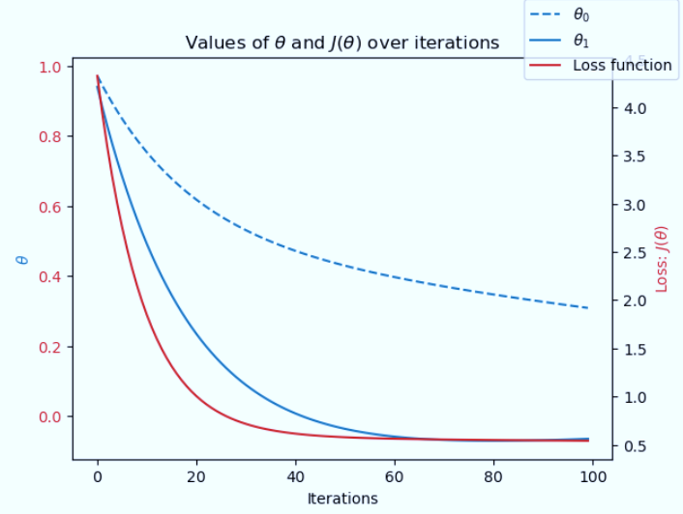
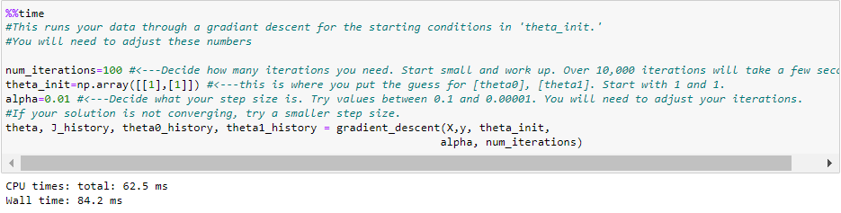
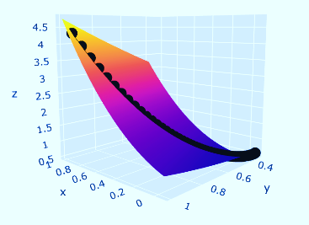
Gradiant Descent
Initial parameters:
Iterations=100, step size=0.01, theta0=1, theta1=1
The loss function graph shows that we have achieved the minimum losses for 60 iterations. So we can reduce the number of iterations and save the time for running the algorithm which can be crucial with large data sets.
3-D vitalization displays Z – Loss function. X-Theta0, Y-Theta1
We can determine that when the loses takes toward the minimum Z=0.54, theta0 and theta1 are X=-0.065, Y=0.310. On the next step we ran the gradient descent with adjusted initial parameters.
ADD A FOOTER
6
6

Slide 7
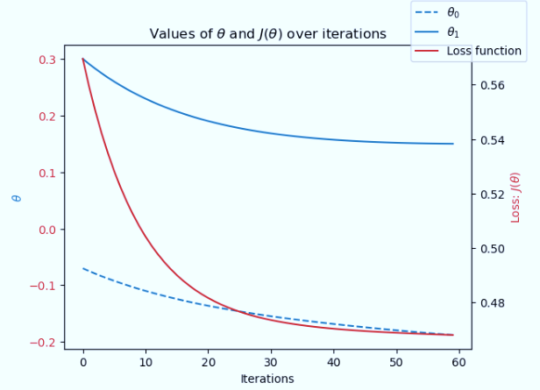
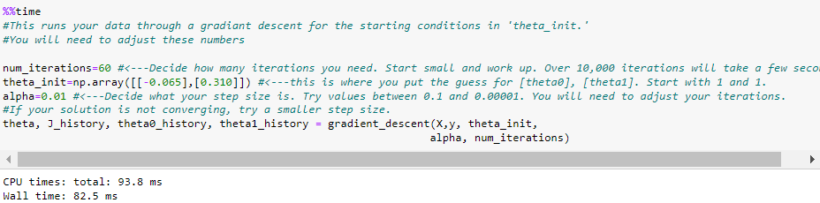
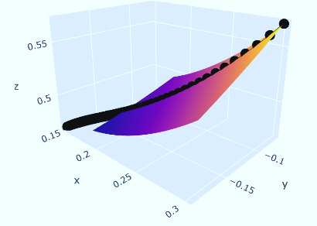
Gradiant Descent
Parameters:
Iterations=60, step size=0.01, theta0= -0.065, theta1=0.310
The loss function has been slightly reduced to 0.46 vs 0.50 in the first attempt. However, the assumption that fewer iterations allows us to decrease the time for rerunning the algorithm has been wrong.
Although, we have succeeded to achieve the lower level of loss, the result is still far from zero. There is still place for improvement.
ADD A FOOTER
7
7

Slide 8
Supervised Machine Learning
K-Nearest Neighbors (kNN) Classifier
Decision Tree Algorithms
The k-nearest neighbors classifier (kNN) is a non-linear supervised machine learning algorithm. It classifies objects based on their proximate neighbors’ classes. It works well with data in which the relationship between variables is not a straight line.
Decision Tree algorithms are referred to as CART or Classification and Regression Trees. The way decision trees classify data is similar to a questions game — with a list of forking branches that lead to an eventual answer. Each decision narrows down a solution by asking for more and more specific information. They’re very good when working with nonlinear data sets as they can easily locate patterns within the data.
Artificial Neural Networks (ANN)
Analysis
Artificial Neural Network(ANN) uses the processing of the brain as a basis to develop algorithms that can be used to model complex patterns and solve prediction problems. ANN is technically a supervised learning model, but it can act like an unsupervised model, which leads to more complex results.
The weather data of 15 weather stations have been selected as well as the data containing the answers whether the weather was considered as pleasant or not on a particular date in the selected locations. We applied three types of supervised algorithms to train the model and check the accuracy of the result.

Slide 9
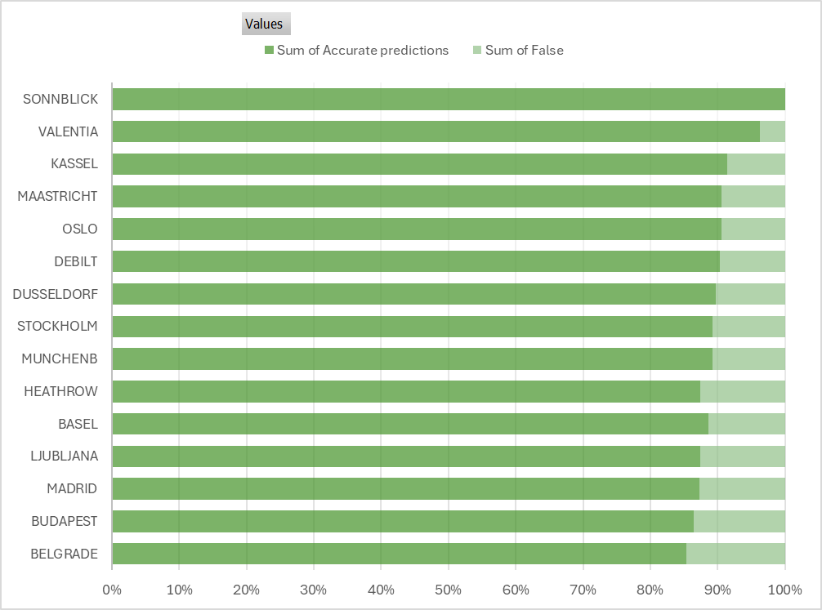
K-Nearest Neighbors Algorithm
The confusion matrix, which helps us to understand how accurate the model is, shows that the accuracy rate of kNN varies from 85% to 100% in the selected 15 weather stations. The misclassified data accounts maximum 15% of the variable. This can be considered a good overall result for the model. The misclassified variable may be the result of the presence of noise or outliers.
For the weather station on Sonnblick, the model achieves 100% of accuracy rate. This means the algorithm learns the data too well. This might also be evidence of model is overfitting and may lead to errors when predicting future results.
Advantages of KNN:
It is fast to develop and simple to interpret.
It can be used for both classification and regression problems.
It is useful for large datasets.
Weaknesses of KNN algorithm:
It is more memory-consuming than other classifying algorithms
performs worse on more complex tasks.
requires scaling (normalization and standardization).

Slide 10
Artificial Neural Network
ANN is a powerful technique which can be used for large data sets and complex relationship, for forecasting. It would be especially beneficiary for the data with high volatility. However, to achieve a suitable result, we may need to do many iterations as the output can be unpredictable.
The highest accuracy score that we have achieved trying different model features is 59.5% on testing data.
Test | Num of hidden layers | Num of nodes (layer_1) | Num of nodes (layer_2) | Num of nodes (layer_3) | Max iterations | Tolerance | Accuracy score (train) | Accuracy score (test)
Test 1 | 2 | 10 | 5 | 0 | 500 | 0.0001 | 0.505984 | 0.515685
Test 2 | 3 | 100 | 50 | 25 | 1000 | 0.0001 | 0.676853 | 0.595155
Test 3 | 3 | 100 | 50 | 25 | 1000 | 0.00001 | 0.572914 | 0.524747
Test 4 | 3 | 100 | 50 | 25 | 2000 | 0.0001 | 0.660121 | 0.591495
Advantages of ANNs:
They are able to learn non-linear data and model complex relationships, numeric, linguistic and visual type of system.
After learning, ANNs can make predictions on unseen data.
They have the ability to learn hidden relationships and can better model data with non-constant and highly volatile variance.
It can be beneficiary for a large data set due to its high-level adaptability. ANNs can be used for supervised, unsupervised and deep learning.
Disadvantages of ANNs:
It takes time to train the model and the results can be different for each iteration.
To some extent, ANNs are unpredictable and running the training can result in different solutions.

Slide 11
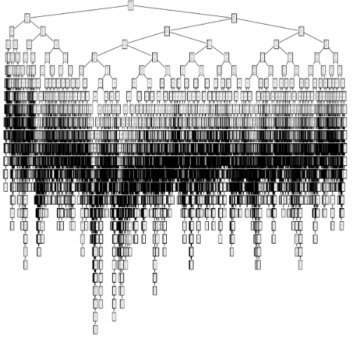
Decision Tree Algorithm
The accuracy that we get applying this algorithm is 60%. However, we can see that the visual presentation is extremely complex. This issue should be handled. This is also a time-consuming model.
Advantages of classification and regression tree (CART):
It can handle numerical and categorical data.
It doesn’t require special data preparation.
It can be used for nonlinear data.
The decision tree can be pruned by applying a certain number of splits.
Disadvantages of CART
For linear data, the decision tree algorithms can create over-complex trees which will be difficult to generalize and interpret.
The output of the leaning can be biased if some classes in the data dominate.

Slide 12
Conclusions
Recommendations
Next Steps
All the models mentioned above have their pros and cons. And all of them can be applied for the purpose of ClimateWins project. It should be mentioned that none of these techniques converged totally, and the level of losses is still high. This means that we need to research further, especially how we can reduce the losses and increase the accuracy rate.
Although the accuracy rate of ANN model is not the best among the applied algorithms, ANN covers the advantages of two other models and can be used for forecasting. I would suggest using the Artificial Neural Network model for the purpose of this project. But we definitely need to find a way of improving the model performance, avoid overfitting and biased solutions.
Continue testing how models’ performance can be improved through unsupervised machine learning.
Research for unsupervised models that can be used for weather predictions.
Try a combination of supervised and unsupervised machine learning.

Slide 13


THANK YOU!
Oksana Stepanova
Let’s get in touch
LinkedIn
GitHub
Email

